Slide 1
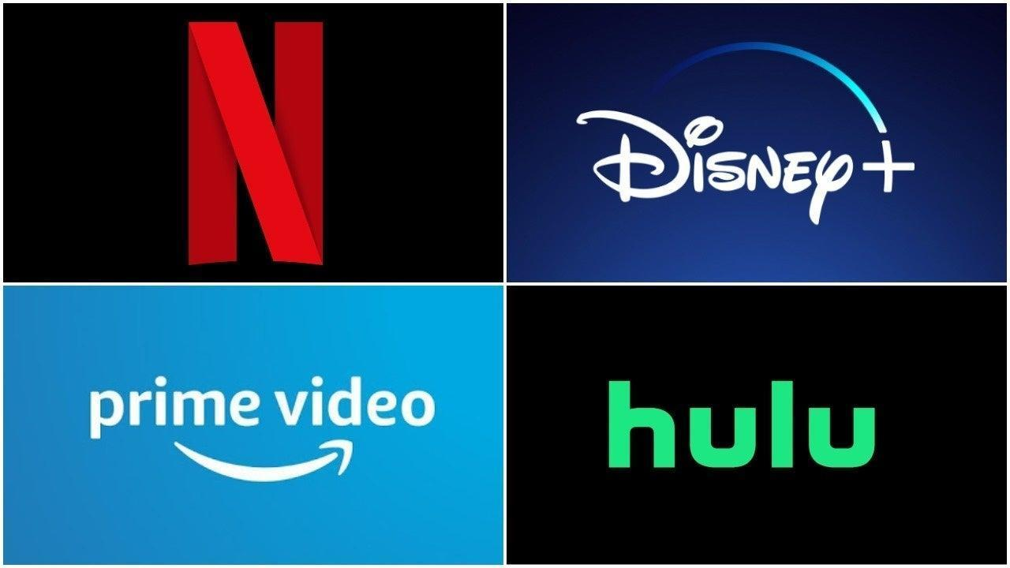


Home TV Shows Movies Recently Added My List
KIDS DVD
Streaming Wars
2022
TV-PG
A Georgia Tech Production
Ten data analysts come together to talk about the important stuff - Which Streaming Platform is the Best to Subscribe to?
▶ PLAY
+ MY LIST
Starring:
Lampton, Jarvis
Person, Dantrell
Lam, Diana
Jackson, Stephen
Ortiz, Elena
Su, I ju
Starrett, Connor
Bilal, Mohamed
Patel, Ami
Nguyen, David
OVERVIEW GENRES & RATINGS INTERNATIONAL RATINGS DETAILS
Notes:
Creative Commons Attribution-NonCommercial-ShareAlike 4.0 International
EdTechPicks.org 2019-11-02

Slide 2

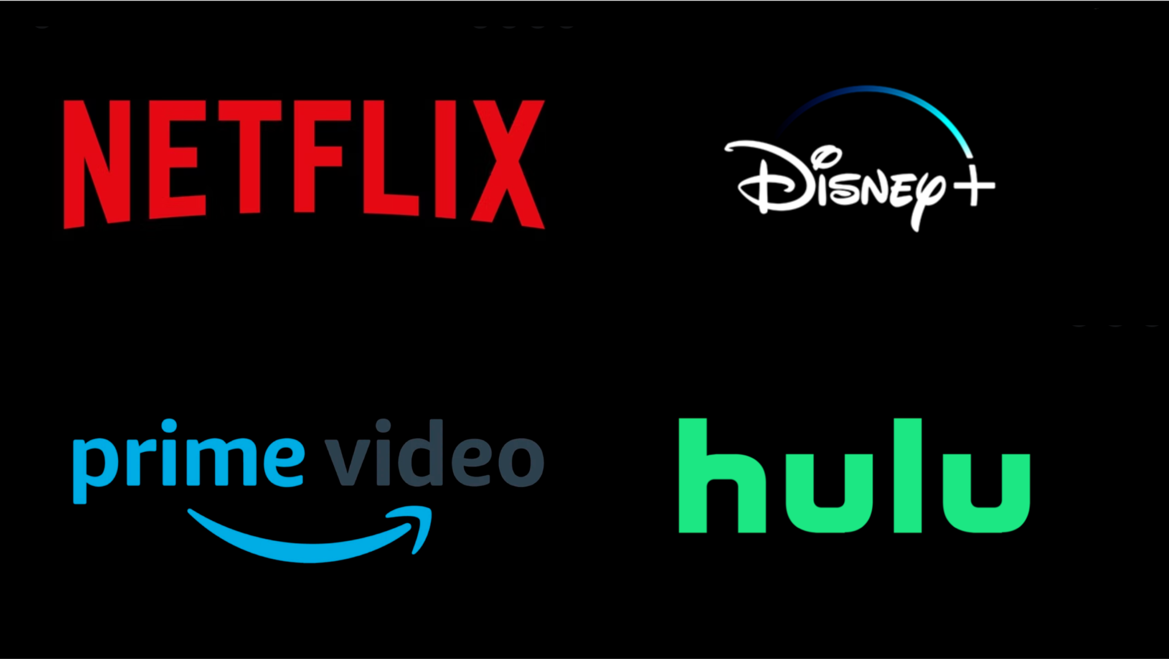
Data
Dataset used: https://www.kaggle.com/datasets/ruchi798/movies-on-netflix-prime-video-hulu-and-disney
This movie data set is accurate to 8 months ago
Cleaning
Original version had 9000 rows of data
Final version had 4362 rows of data after doing API pull from OMDB
Analyzed over 4300 movie titles across 4 major platforms: Netflix, Prime Video, Hulu, Disney+

Slide 3
Home TV Shows Movies Recently Added My List
KIDS DVD
WHAT STREAMING PLATFORM IS BEST TO SUBSCRIBE TO?
Season 1
Which streaming platform provides the most diverse selection of genres and movies ratings?
S1:E1 - Distro of movies for each platform
S1:E2 - Distro of genres
Season 2
Which platform is most prevalent in the most countries?
S2:E1 - Distro of countries for each platform
S2:E2 - Ratings by Country
Season 3
Which streaming platform is the most popular based on movie ratings?
S3:E1 - Runtime by movie rating
S3:E2 - Avg movie ratings by platform
Season 4
Which factors impact the movie rating the most?
S4:E1 - Avg ratings by decade
S4:E2 -Distro by decade
S4:E3 - Avg rating by runtime by movie rating
OVERVIEW EPISODES TRAILERS & MORE MORE LIKE THIS DETAILS
EdTechPicks.org
Notes:
Creative Commons Attribution-NonCommercial-ShareAlike 4.0 International
EdTechPicks.org 2019-11-02

Slide 4
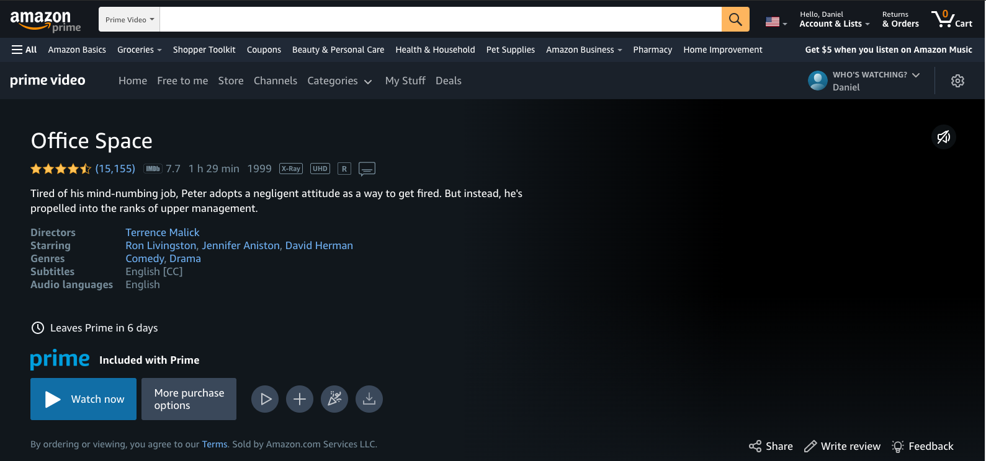
Dr. A
WHO’S WATCHING?
Dr. A
S1:
Which streaming platform provides the most diverse selection of genres and movies ratings?

Slide 5
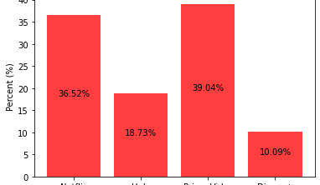
Home TV Shows Movies Recently Added My List
KIDS DVD
S1:E1 DISTRIBUTION OF MOVIES FOR EACH PLATFORM
Based on the OMDb list, Prime Video has the highest number of movies (1703) which is 39.04% of the movies in OBDb list, then Netflix (1593) with a percentage of 36.52%, then Hulu (817) which a percentage of (18.73%), then Disney+ (440) with a percentage of 10.09%.
OVERVIEW EPISODES TRAILERS & MORE MORE LIKE THIS DETAILS
Notes:
Creative Commons Attribution-NonCommercial-ShareAlike 4.0 International
EdTechPicks.org 2019-11-02

Slide 6

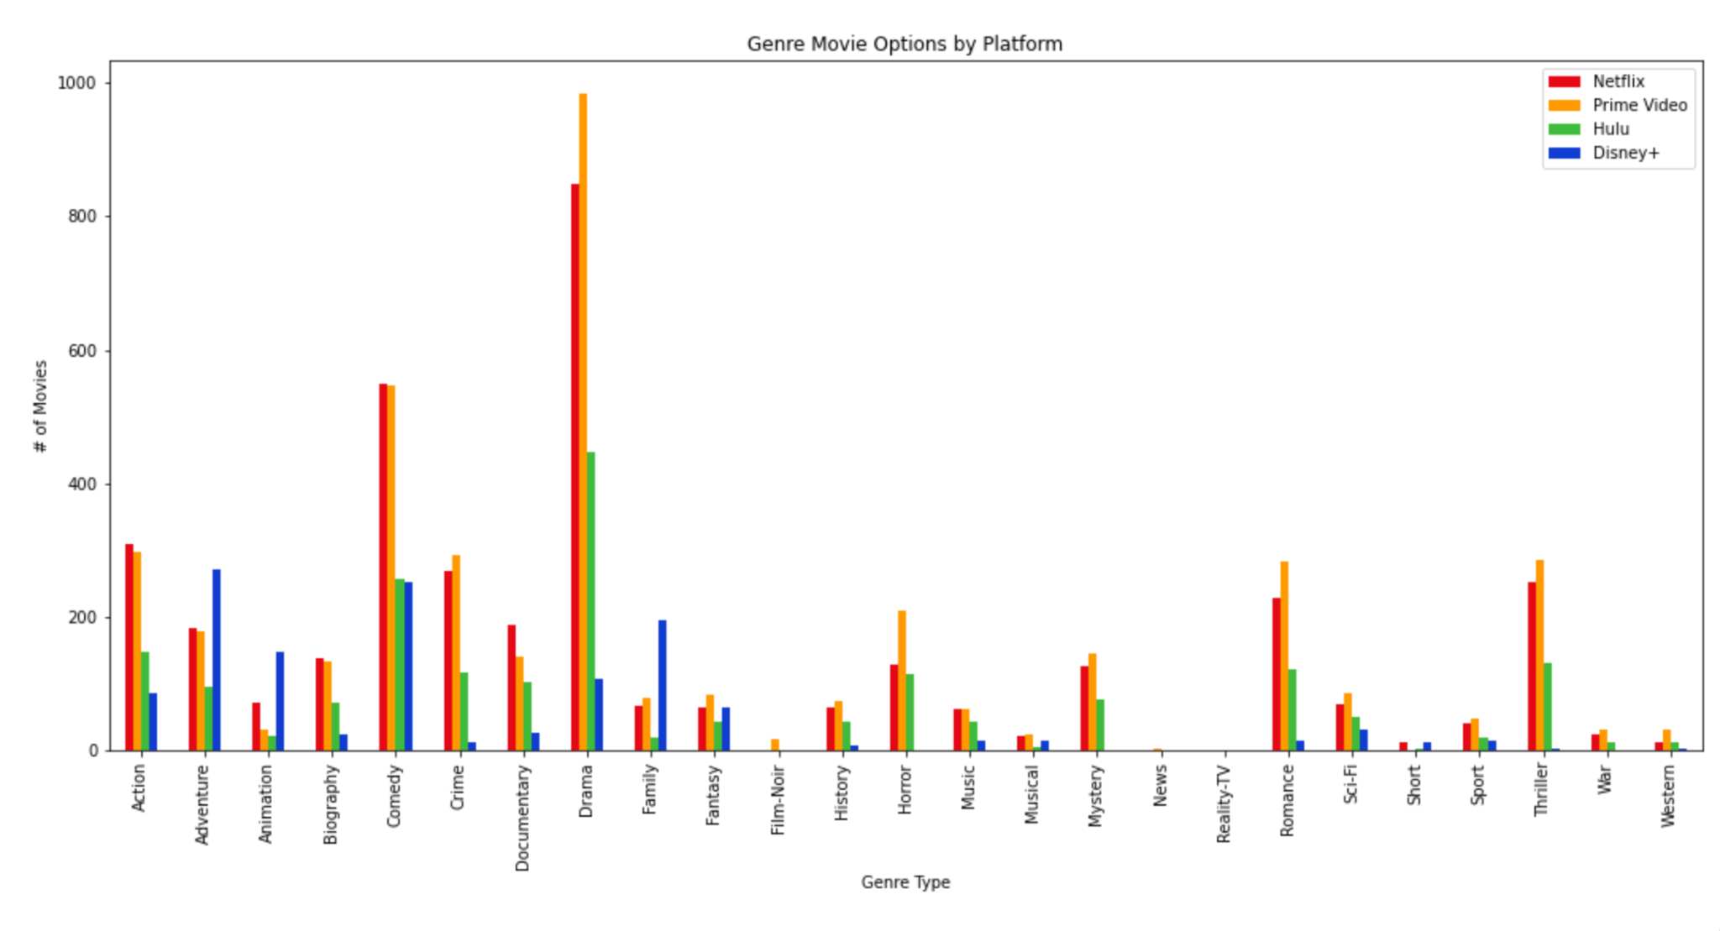

S1:E2 DISTRIBUTION OF GENRES
Question
SLIDE NUMBER
Sub Group Members: X, Y, Z ◯ Creator: Your Name
To highlight a few key findings found by comparing genres across streaming platforms:
Netflix and Prime represented well in all categories of genres, rating in the top two for each nearly every genre.
Disney+ presented the highest number of family films among the platforms and showed a niche towards family/kid relevant films.
While Hulu did contain variety of genres, it seemed to be focused on providing viewers with films in the Drama genre.
Detailed Description

Slide 7
Dr. A
WHO’S WATCHING?
Dr. A
S2:
Which platform is most prevalent in the most countries?

Slide 8

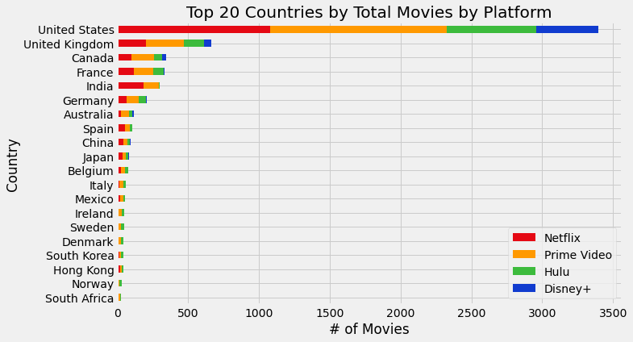
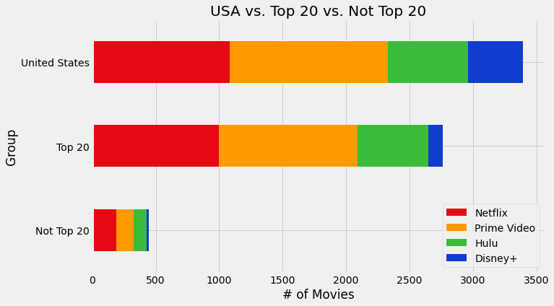

Which platform is most prevalent in the most countries?
2022 1m
What is the distribution of platforms for each country?
S2:E1 - Distribution of Countries for Each Platform
By and Large, the United States comes out on top for most content across each platform even when grouping the Top 20 and Not Top 20.
Duration:
1m
Release Date:
August 2, 2022
Sub Group Names:
Diana, Stephen
Rating:
Directors:
Stephen
Notes:
Creative Commons Attribution-NonCommercial-ShareAlike 4.0 International
EdTechPicks.org 2019-11-02

Slide 9
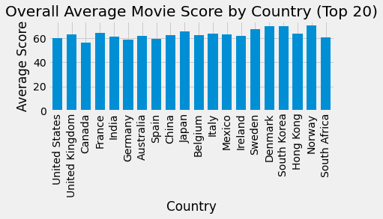
Which country has the most and best movies by overall rating?
Which country has the best movies by overall rating?
S2:E2 - Movie Scores by Country
Despite having the most available content, the United States falls to 17th place in terms of average rating with 60.216. Meanwhile Norway, Denmark and South Korea finish in the top 3. Canada finished dead last with 55.938.
Duration:
1m
Release Date:
August 2, 2022
Sub Group Names:
Diana, Stephen
Rating:
Directors:
Diana
Notes:
Creative Commons Attribution-NonCommercial-ShareAlike 4.0 International
EdTechPicks.org 2019-11-02

Slide 10
Dr. A
WHO’S WATCHING?
Dr. A
S3:
Which streaming platform is the most popular based on movie rating?

Slide 11
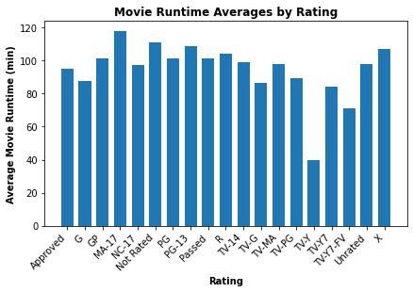
S3:E1 RUNTIME BY MOVIE RATING
Question
SLIDE NUMBER
Sub Group Members: Ami Patel & David Nguyen ◯ Creator: Ami Patel
According to the results, across all platforms the average movie runtime was the lowest for TV-Y (a rating which is programming that is appropriate for children of all ages). Therefore, most platforms lean towards mature ratings which most likely means Disney+ would be the platform that is more appropriate, thereby giving a TV-Y rating.

Slide 12
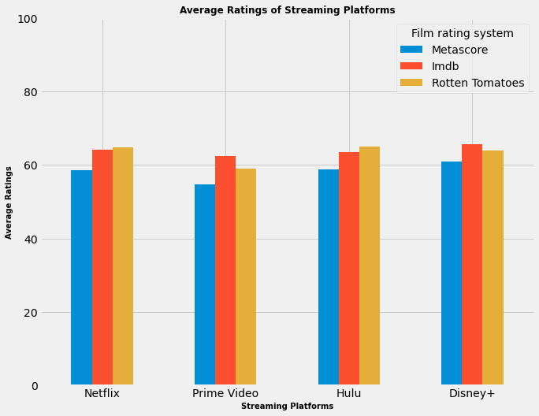
S3:E2 AVERAGE MOVIE RATINGS BY PLATFORM
Question: Which streaming platform has the highest movie ratings?
2022 1m
This bar chart displays the average movie ratings for each platform.
Disney+ has the highest average Metascore and Imdb ratings.
Hulu has the highest average Rotten Tomatoes ratings.
Overall Disney + has the highest average of average movie ratings.
Duration:
1m
Release Date:
August 2, 2022
Sub Group Names:
Ami Patel & David Nguyen
Rating:
Director:
David Nguyen
Notes:
Creative Commons Attribution-NonCommercial-ShareAlike 4.0 International
EdTechPicks.org 2019-11-02

Slide 13
Dr. A
WHO’S WATCHING?
Dr. A
S4:
Which factors impact the movie rating the most?

Slide 14
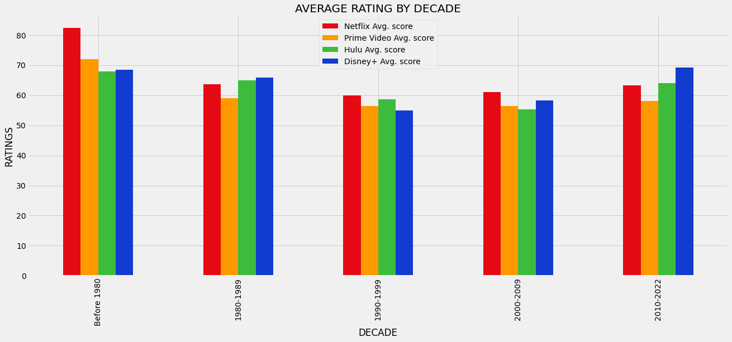
Home TV Shows Movies Recently Added My List
KIDS DVD
S4:E1 AVERAGE RATING BY DECADE
This Graph displays the avg rating of each platform by decade.
Netflix has the highest avg. rated movies before the 80’s,90’s,and the 2000’s.
Disney+ has the highest avg. rated movies in the 90’s and 2010’s.
Overall Netflix has the best overall selection of movies based on ratings.
OVERVIEW EPISODES TRAILERS & MORE MORE LIKE THIS DETAILS
Notes:
Creative Commons Attribution-NonCommercial-ShareAlike 4.0 International
EdTechPicks.org 2019-11-02

Slide 15
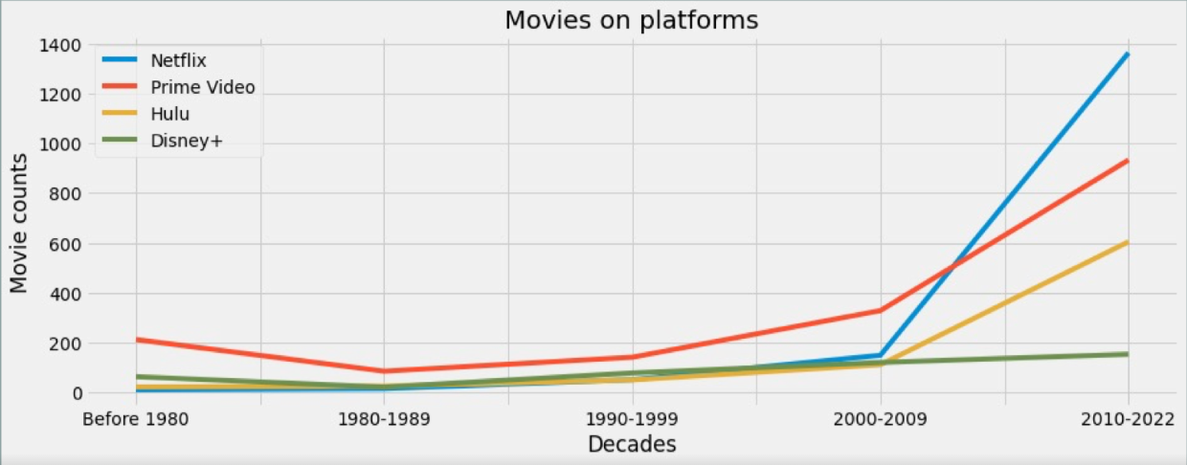
Home TV Shows Movies Recently Added My List
KIDS DVD
WHO’S WATCHING?
Dr. A
Streaming Wars S4: E2 Movies BY DECADE
The plot shows the quantity of movies by decades on each platform.
People who like old movies will have more choices on Prime Video, for people who are more interested in newer movies Netflix will be the best.

Slide 16
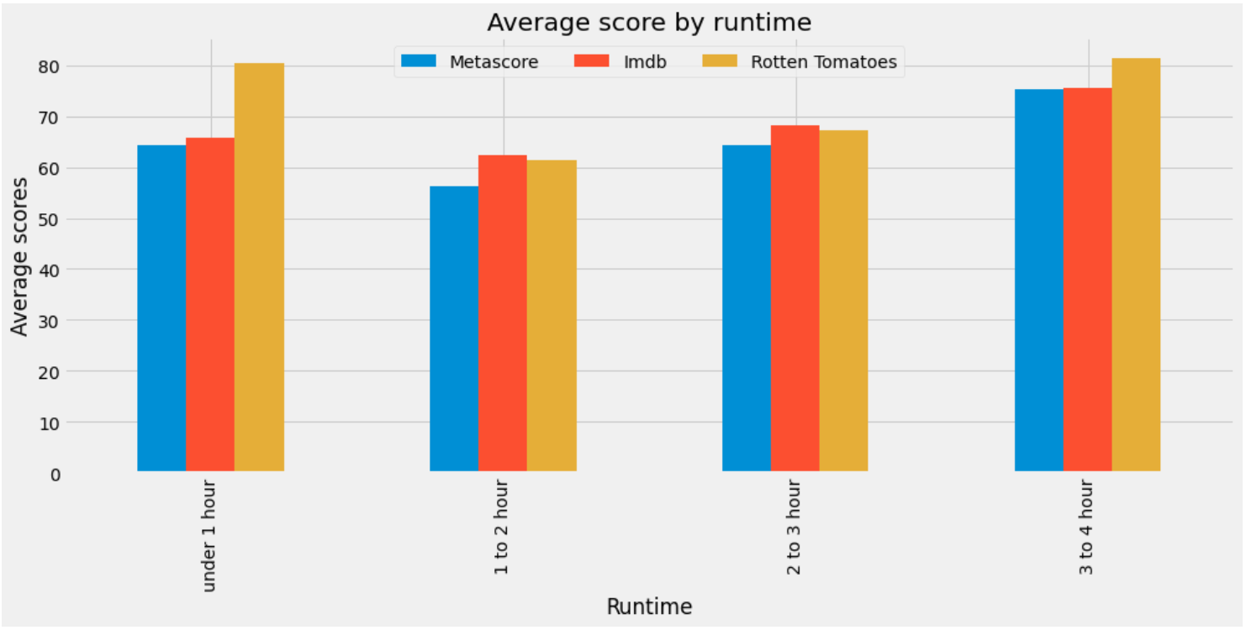
Streaming Wars S4: E3 AVERAGE RATING
BY RUNTIME
2022 1m
Question: Do critics give preferential reviews based on how long the media is?
Average Rating by Runtime
Rotten tomatoes tends to give preference to longer and shorter runtimes.
Under 1 hour and over 2 hours tends to receive higher ratings from critics.
Duration:
1m
Release Date:
August 2, 2022
Sub Group Names:
Jarvis, Su, Connor
Rating:
Director:
Connor
Notes:
Creative Commons Attribution-NonCommercial-ShareAlike 4.0 International
EdTechPicks.org 2019-11-02

Slide 17
Summary of Findings
Season 1
Which streaming platform provides the most diverse selection of genres and movies ratings?
Season 2
Which platform is most prevalent in the most countries?
Season 3
Which streaming platform is the most popular based on movie ratings?
Season 4
Which factors impact the movie rating the most?
The “best” platform depends on what you are yearning for from your streaming platform.
If you are searching for quantity and variety, Prime Video has the highest number of movies and Netflix has the most variety of genres.
Prime Video has the most amount of movies to offer to most amount of countries.
When it comes to popularity of a streaming platform based on movie ratings, the data demonstrates that Disney+ has the highest ratings.
In 2010s, Netflix has the most movie production, consequently the movie ratings dramatically decreased .

